Slide 1

INCS 4810 Culminating Project Jason Dhaliwal – Jevin Heer – Gursher Singh

Slide 2
Project Overview
Designed a virtual test network with vulnerabilities to simulate a cyberattack on an ICS network.
Following the ISA-62443 standard for assessing and mitigating vulnerabilities.
Goal is to demonstrate potential impact of a cyberattack and importance of cybersecurity measures.

Slide 3
Virtual Test Network Architecture
Business network with Windows 10 machine, AD, DNS server, IT workstation.
ICS network with engineering workstation, PLC, HMI, maintenance workstation, historian.
Internet-facing components like Kali Linux machine, mail server, firewall.

Slide 4
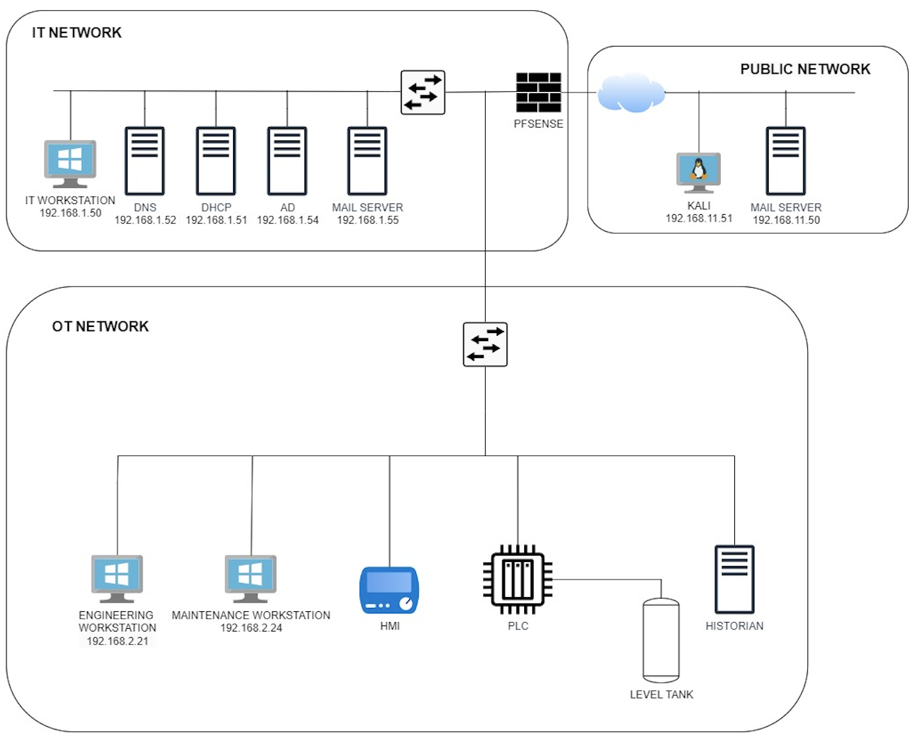

Slide 5
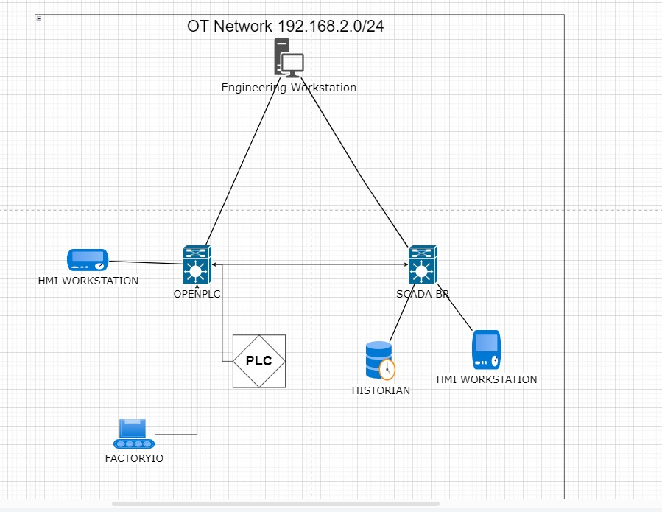

Slide 6
Vulnerabilities Introduced
Weak passwords on Windows 10 and engineering workstation.
Lack of secure network segmentation between business and ICS networks.
Absence of IDS/IPS systems.
Unpatched or outdated software on ICS components.
Lack of employee cybersecurity training initiatives, which leave the network susceptible to phishing and other social engineering attacks.

Slide 7
Setup and Configuration Completed
Installed and configured VMware virtualization software.
Created virtual machines for business network components.
Set up virtual machines/simulation applications for ICS network.
Configured network settings and established connectivity between networks.
Tested basic functionality and resolved any issues.

Slide 8
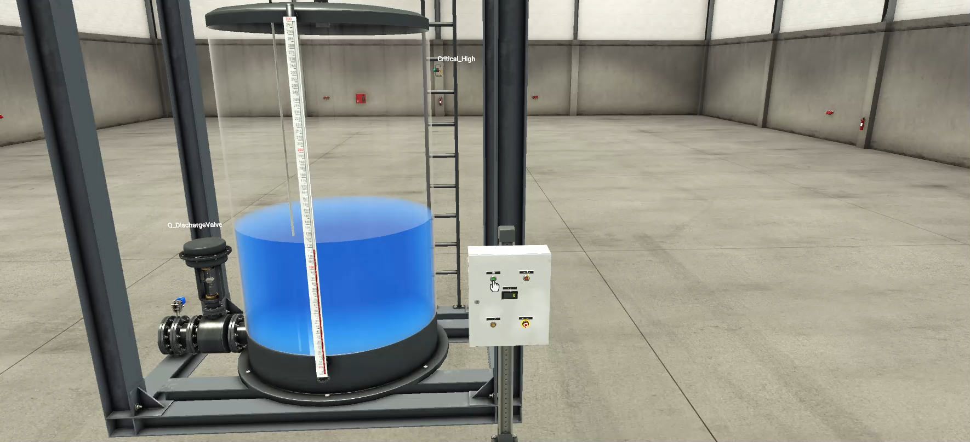
Simulated OT Process

Slide 9
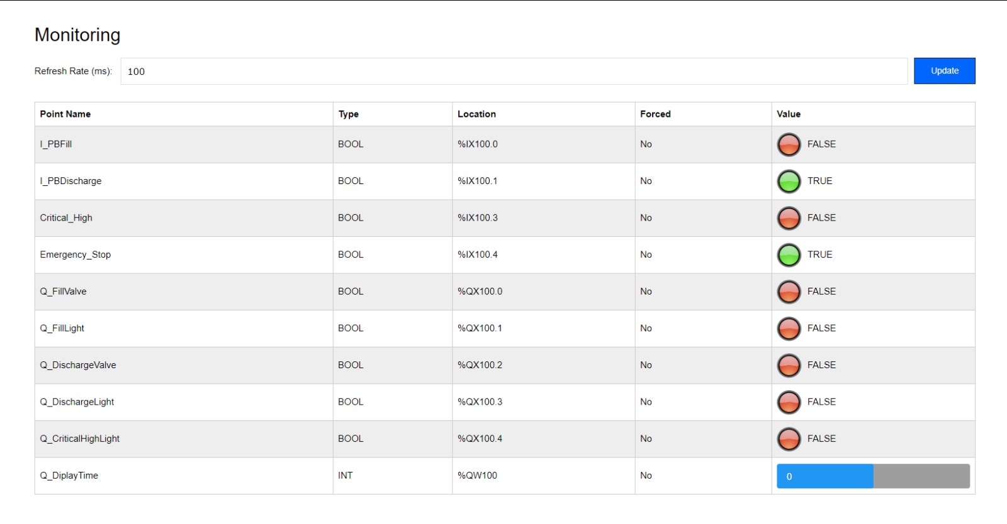
OpenPLC HMI

Slide 10
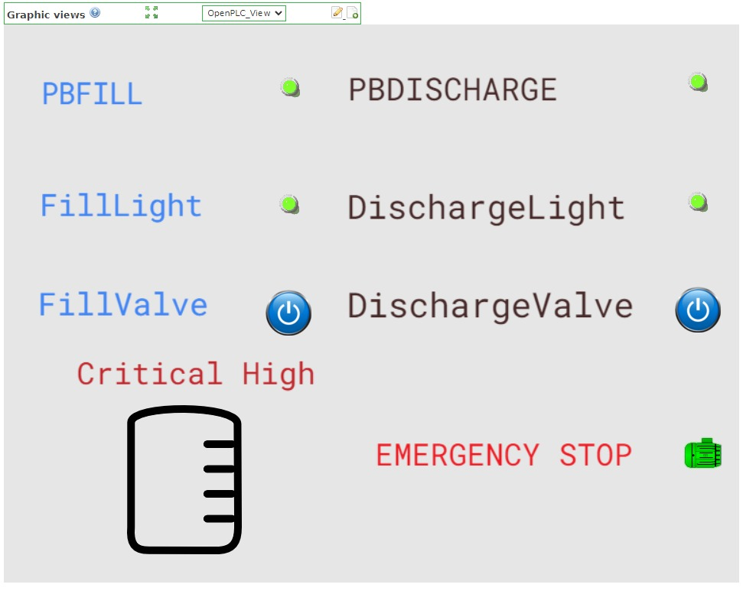
SCADA BR HMI

Slide 11
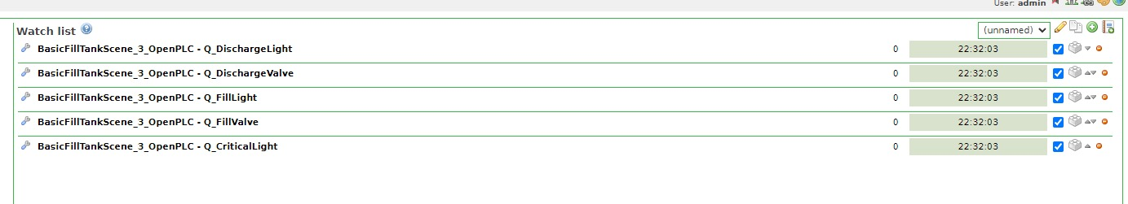
Scada br

Slide 12
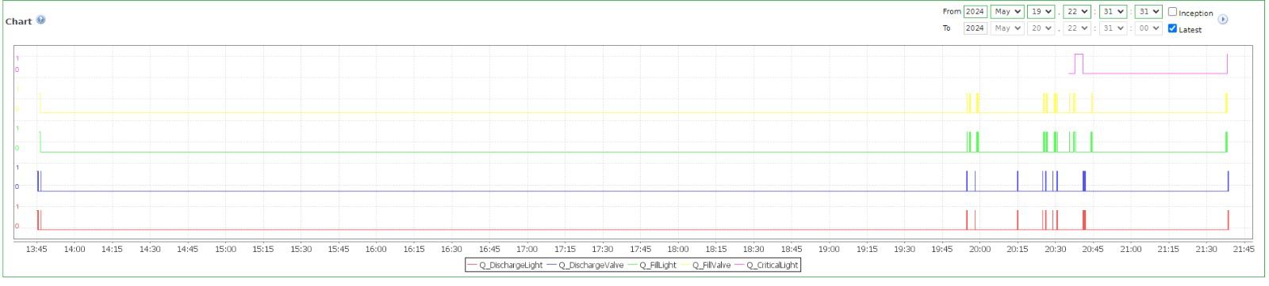
historian

Slide 13
Ready for Simulated Cyberattack
Virtual test network with intended vulnerabilities is operational.
Next step is to conduct the planned cyberattack scenario.
Phishing email attack to gain access to Windows 10 IT Workstation machine.
Exploit social engineering vulnerabilities to gain credentials for the Engineering workstation.
Pivot to engineering workstation on the OT side.

Slide 14
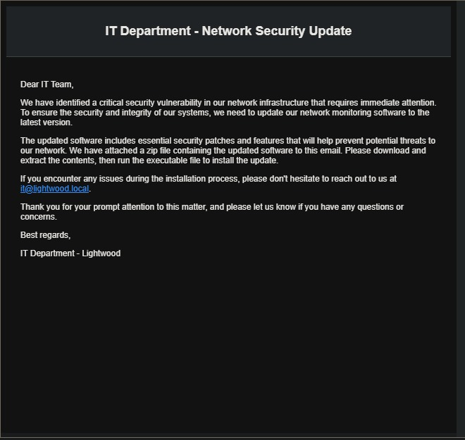

Slide 15
Cyberattack IT Workstation Details
We enable port listening on port 4545.
A phishing email is sent out to the it workstation.
Once the victim clicks on the downloads the zip file, they are given instructions to unzip the executable file.
When the executable file is run, a reverse shell is created allowing us to have control over the victim’s command prompt.
The victim only sees a blank command prompt that is open while we commence the attack.

Slide 16
Gaining access to the Engineering workstation
Once the IT workstation runs the exe file we will run nmap on network 192.168.1.0/24, 192.168.2.0/24 and the host 192.168.2.20.
Nmap will provide us details of the network devices, showing us which devices are connected and running, and the host nmap will show which ports are open which will show us if we can rdp into the workstation.
After confirming we can rdp into the workstation we will use a list of known usernames and passwords to brute force the credentials for the engineering workstation.
Once we get the credentials, we will rdp into the workstation and gain full control over the process.

Slide 17
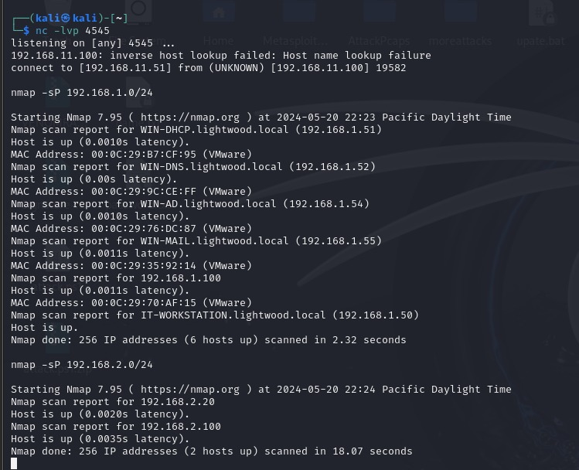

Slide 18
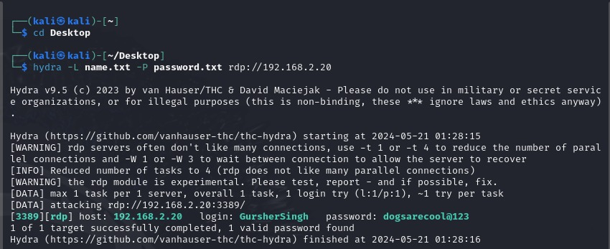

Slide 19
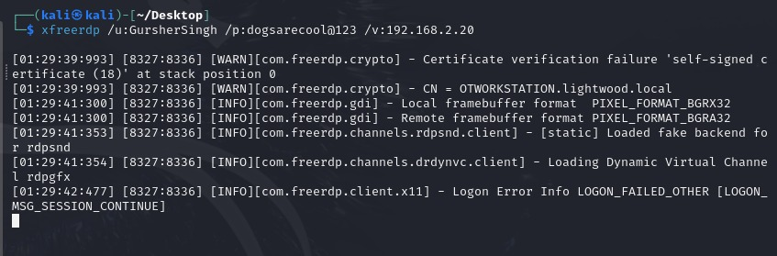
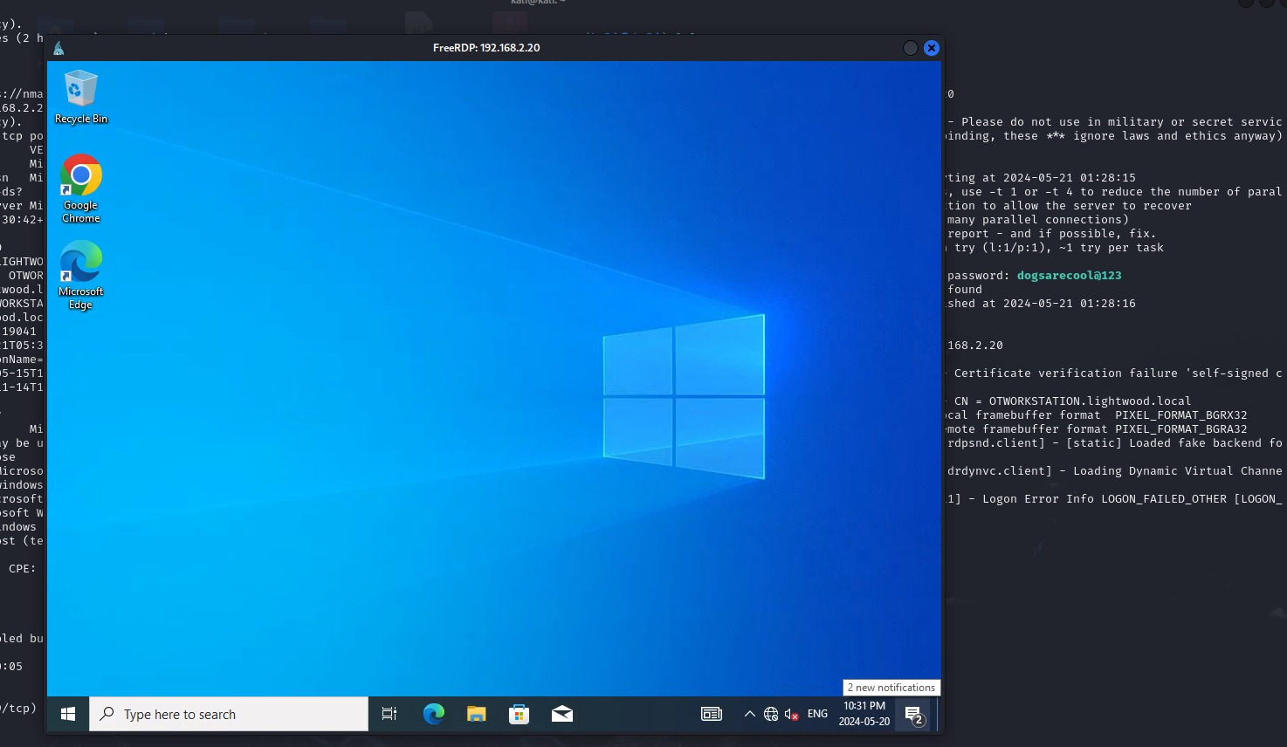

Slide 20
Manipulating the process
When we have obtained command and control over the engineering workstation, we will edit the parameters for filling the tank. changing the time to fill from the set value of 8 seconds to 60 seconds to cause the tank to overflow.
We will also disable the alarm for the critically high value as well as disabling the emergency stop function of the process.
By causing the tank to overflow we will cause damage to the factory and create a safety incident due to the hazardous liquid pouring onto the factory floor.

Slide 21
Implementing defenses
Implement Industrial Demilitarized Zone (IDMZ)
Create a separate network segment between the IT and OT networks.
Use firewalls to control traffic between the IDMZ and other network segments.
Helps prevent unauthorized access and contains potential threats.
Implement Access Control Lists (ACLs)
Configure network devices to block unnecessary traffic like ping requests.
Restrict access to critical assets and limit lateral movement within the network.
Enforce the principle of least privilege for user and device access.

Slide 22
Implementing defenses
Shutdown All Unused Ports
Identify and disable unused ports on network devices and endpoints.
Reduces the attack surface by eliminating potential entry points for attackers.
Regularly review and update port configurations as network requirements change.
Implement Strong Firewall Rules
Deploy firewalls at key network boundaries (e.g. between IT and OT, IDMZ and OT).
Define strict rules to allow only necessary traffic and deny all else by default.
Regularly review and update firewall rules to ensure they align with security policies.

Slide 23
Implementing defenses
Deploy Security Onion for IDS/IPS
Implement an intrusion detection/prevention system like Security Onion.
Monitor network traffic for suspicious activities and known threat signatures.
Configure alerts and automated responses to detected threats.
Provide Employee Cybersecurity Training
Educate employees on identifying and reporting phishing attempts.
Train on proper handling of sensitive data and access credentials.
Conduct regular awareness programs to keep security top of mind.

Slide 24
Implementing defenses
Change Default Passwords
Identify all devices and accounts using default or weak passwords.
Enforce strong, unique passwords or implement multi-factor authentication.
Regularly require password changes and audit for compliance.

Slide 25
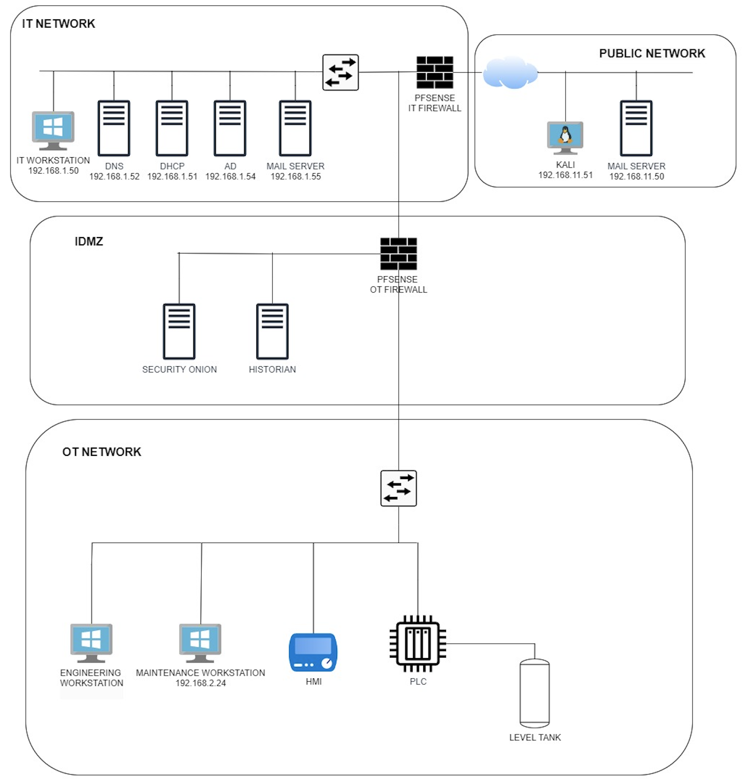

Slide 26
Challenges overcome
difficulty setting up the virtual test network using virtualization software.
Challenges in establishing the client/server connection for the simulated process.
Time constraints impacting the final deliverables.
Windows Defender blocking the download of our payload.

Slide 27
Questions?

Slide 28
Thank you

